Slide 1

Development of methane mitigation strategies using the microalga Chlorella vulgaris
Flash update
Gonçalo Apolinário Cardoso
30 november 2023

Slide 2
Model overview
Organism | Mymodel | Utex395 | C.reinhardtii
Genes | 1296 | 842 | 1073
Reactions | 2569 | 2261 | 2190
Metabolites | 2192 | 1760 | 1707
Compartments | 11 | 6 | 10

Slide 3
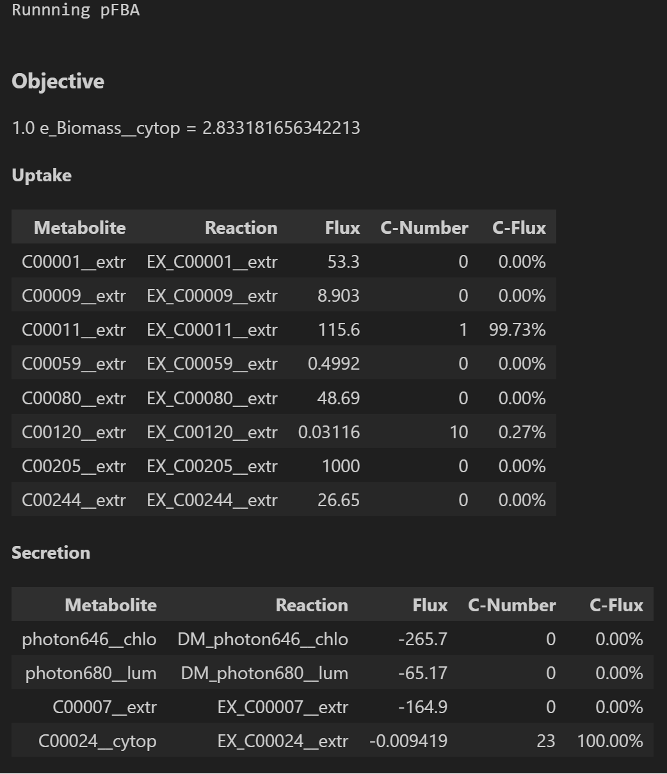
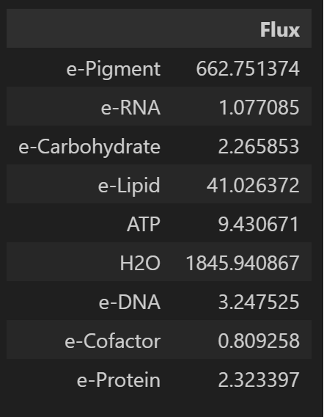

Slide 4
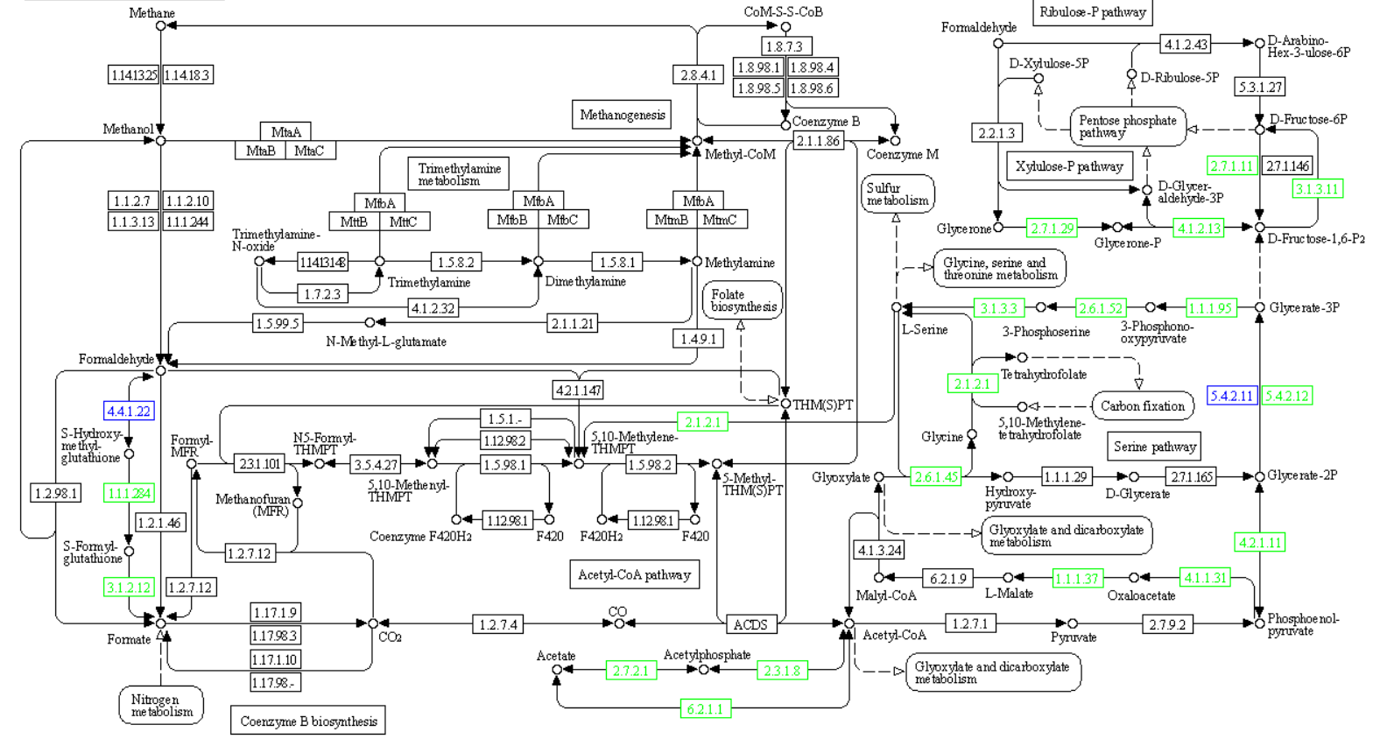

Slide 5
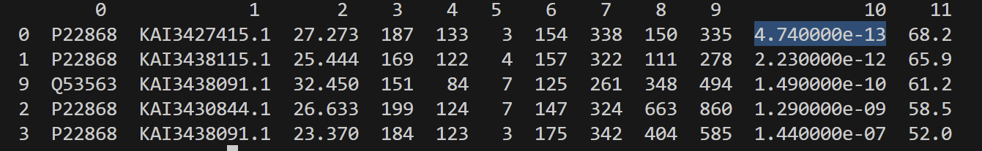
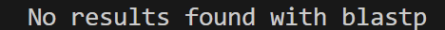
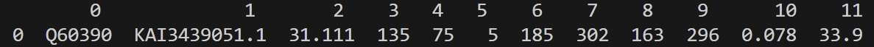
EC number: 1.14.18.3
EC number: 1.14.13.25
Methane/ammonia monooxygenase subunit A (pmoA-amoA)
Methane monooxygenase component A alfa chain (mmoX)
EC number: 2.8.4.1
KAI3427415.1
Methyl-coenzyme M reductase alfa subunit (mcrA)
EC number: 1.6.2.2
NADH: ferricytochrome-b5 oxidoreductase
KAI3439051.1
Caption:
10: e-value
No associated enzyme

Slide 6
Next Steps
Study principal methane consuming genes in closely related eukaryotes

